Slide 1
GAME310 Lesson 05
Artificial Intelligence
Wednesday, Sep 25th, 2019
Professor: Majid Moghadam

Slide 2
Objectives
Section 3: Cars
15. Car Racing With Waypoints
16. Customizing Car Behaviour
17. Unity’s Vehicle System

Slide 3
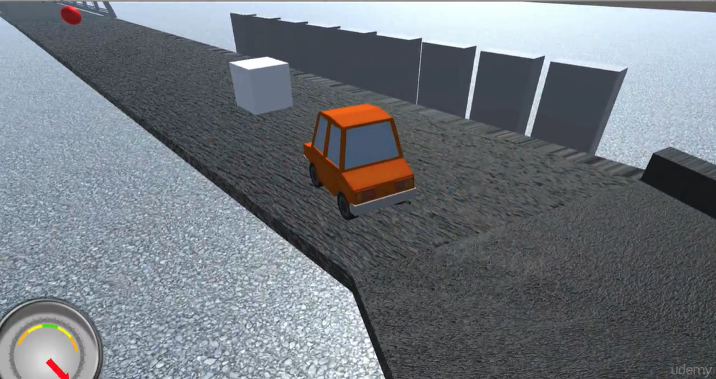
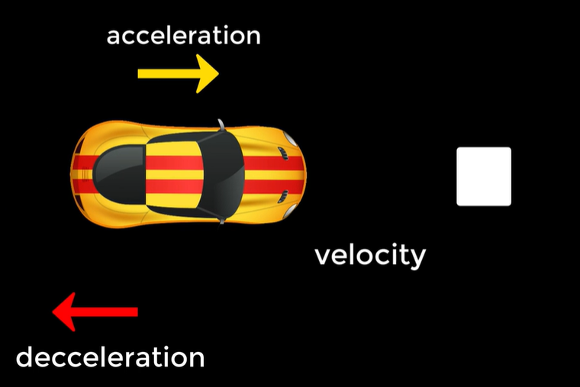
Section 3: Cars 15. Car Racing with Waypoints
Simple AI Cars
We will design the AI for a car racing around the track with the following in mind:
Overall speed is relatively constant (not always constant)
Car slows down (decelerates) as it approaches a turn
Car speeds up (accelerates) as it leaves a turn
We will use similar code to the previous sections where the NPC (the car in this case) follows a goal (cube) as the cube follows the waypoint circuit around the track.

Slide 4
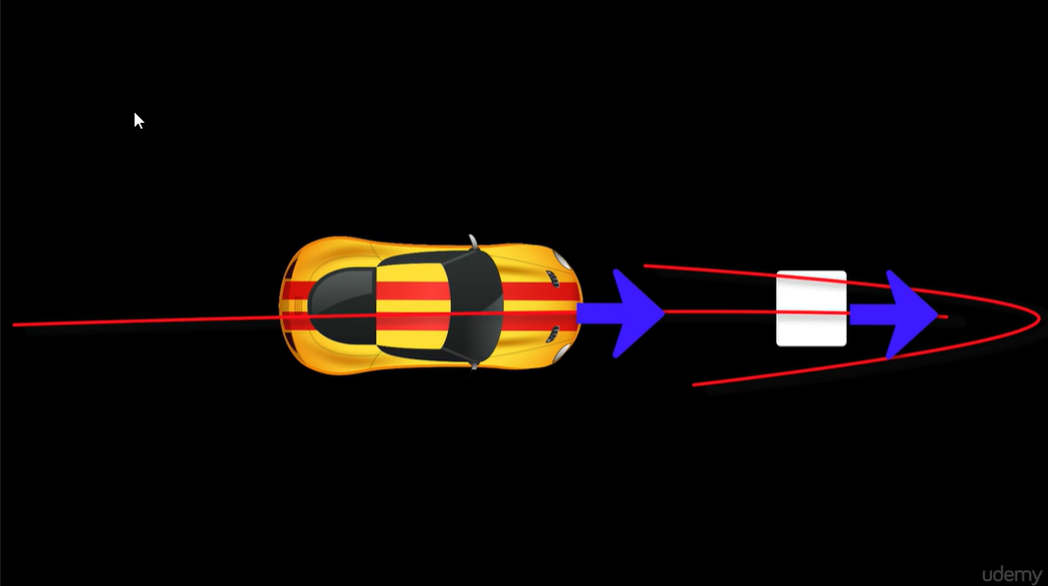
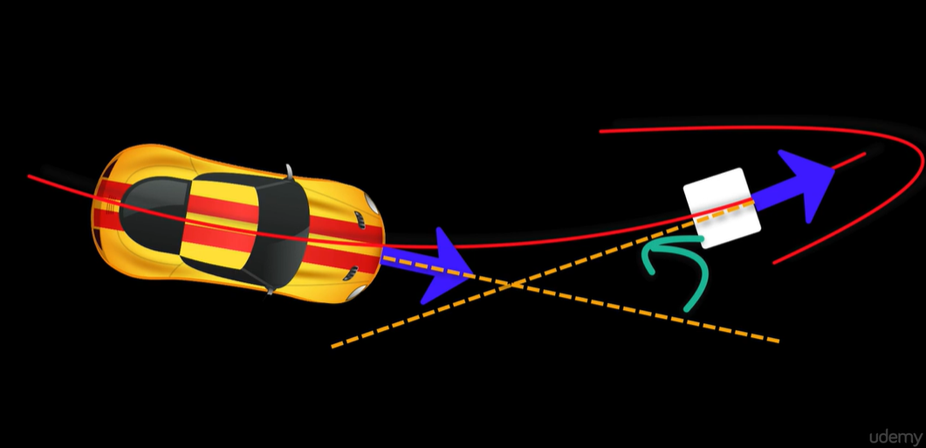
Section 3: Cars 15. Car Racing with Waypoints (cont’d)
Velocity is the vector that represents the speed at which the car moves forward as well as the direction
Acceleration/deceleration are caused by forces which increase/decrease velocity over time
When car is going straight the forward vectors of the car and goal align
When going around a bend, the forward vectors of the car and goal are at angles to one another

Slide 5
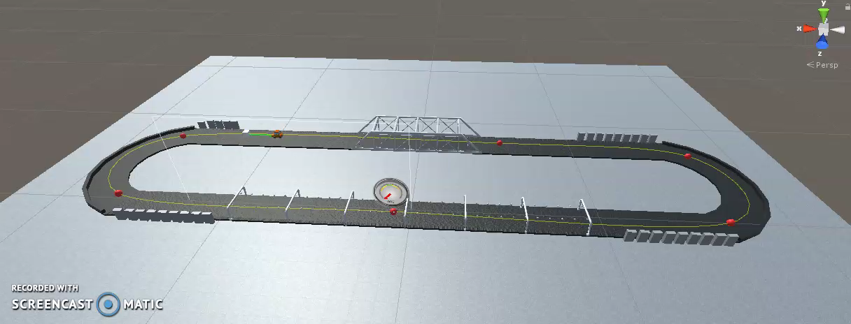
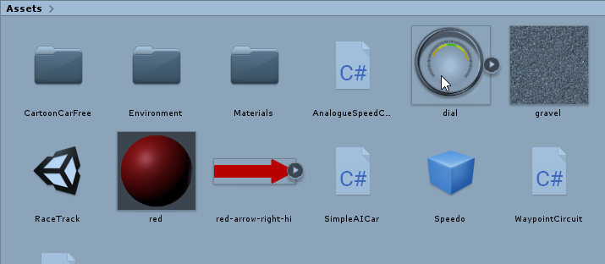
Section 3: Cars 15. Car Racing with Waypoints (cont’d)
The car track provided in the resources has:
Waypoint circuit going around the track
An orange car and a goal (cube)
Uses the Unity’s built in waypoint system, therefore uses ProgressTracker.cs script
The orang car has a script called SimpleAICar.cs
The orange car also has the Waypoint ProgressTracker assigned to it
So the orange car follows the cube, the cube follows the waypoint circuit

Slide 6
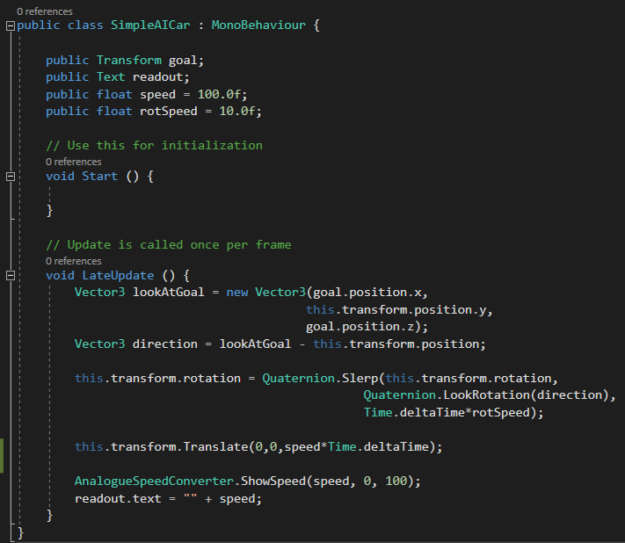
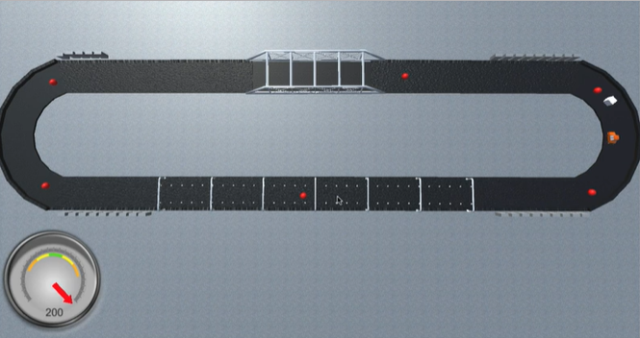
Section 3: Cars 15. Car Racing with Waypoints (cont’d)
The SimpleAICar.cs script is very similar to the previous followGoal.cs script
The main problem with it is the speed of the car is constant, we need to make it more realistic (slow down around bends, speed up as it leaves)
Initial Code car moves at a constant speed

Slide 7
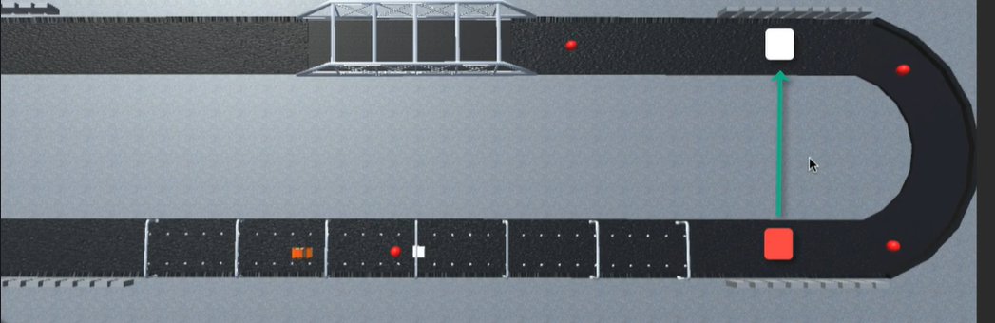
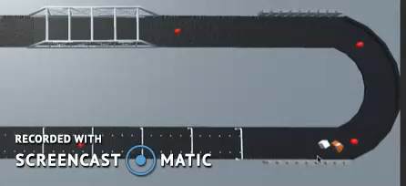
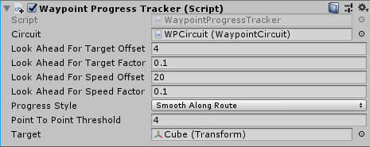
Section 3: Cars 15. Car Racing with Waypoints (cont’d)
Problems
If car lags behind it may cut corners to get to goal
If car is too close it may start to circle the goal erratically (accuracy issue)
By adjusting values in the Progress Tracker on can fix these issues

Slide 8
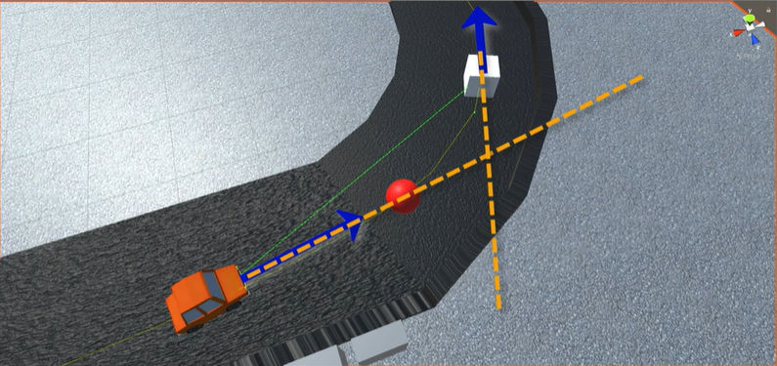
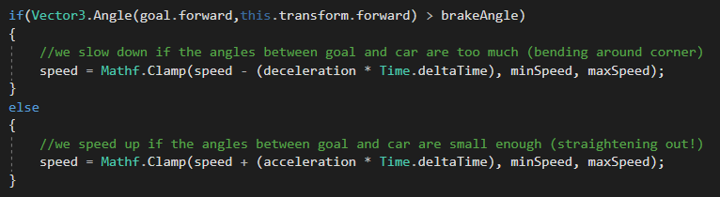
Section 3: Cars 15. Car Racing with Waypoints (cont’d)
Changing the Car’s Speed around the bend
We look at the angle between the forward vector of the cube(the goal) and the forward vector of the car.
If the angle is significant, that means the cube is turning around the bend
If angle gets too big, then decelerate (slow down)
If angle gets small enough then accelerate (speed up)
Bend Angle

Slide 9
Section 3: Cars 15. Car Racing with Waypoints (cont’d)
Changing the Car’s Speed around the bend
We look at the angle between the forward vector of the cube(the goal) and the forward vector of the car.
If the angle is significant, that means the cube is turning around the bend
If angle gets too big, then decelerate (slow down)
If angle gets small enough then accelerate (speed up)
Bend Angle

Slide 10
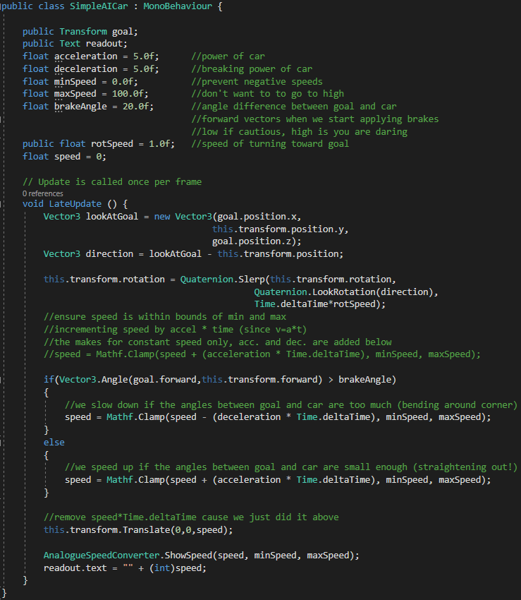
Section 3: Cars 15. Car Racing with Waypoints (cont’d)
Summary of SimpleAICar.cs code
Cube(goal) follows waypoint circuit around track. Progress Tracker involved
Car follows cube
Where is the cube? → direction
Turn towards cube → Slerp
Approaching bend? → Angle
either decelerate
or accelerate
Move → towards cube
Speedometer displays speed

Slide 11
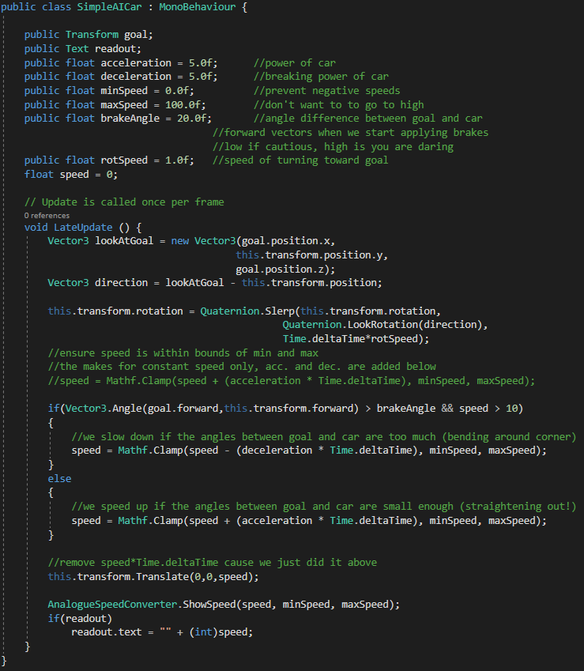
Section 3: Cars 16. Customizing Car Behaviour
Adding another car
Duplicated the orange car
Changed its material to blue
Changed condition of acceleration to include speed (if not moving then don’t look at angle of separation, just accelerate)
Added RigidBody so they do not overlap (physics keeps them separated)
Removed guiding cubes (disabled their mesh renderers)
Disabled speedometer on one car

Slide 12
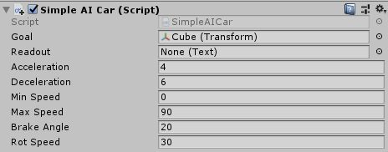
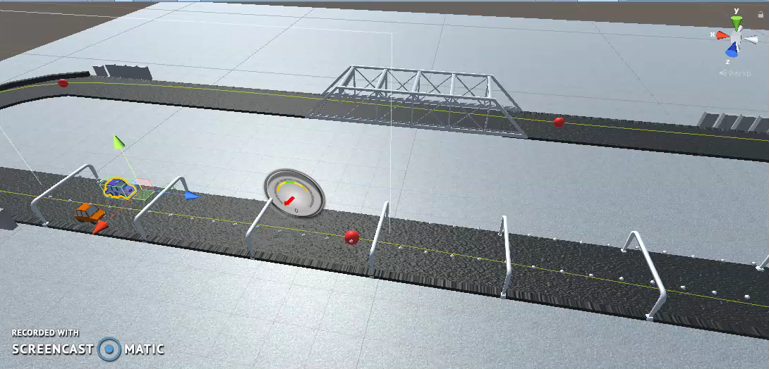
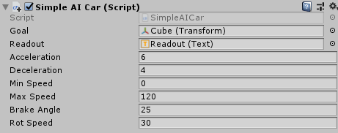
Section 3: Cars 16. Customizing Car Behaviour (cont’d)
Changing both car parameters
Orange car
Blue car

Slide 13
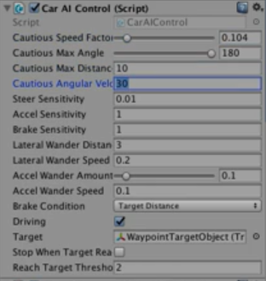
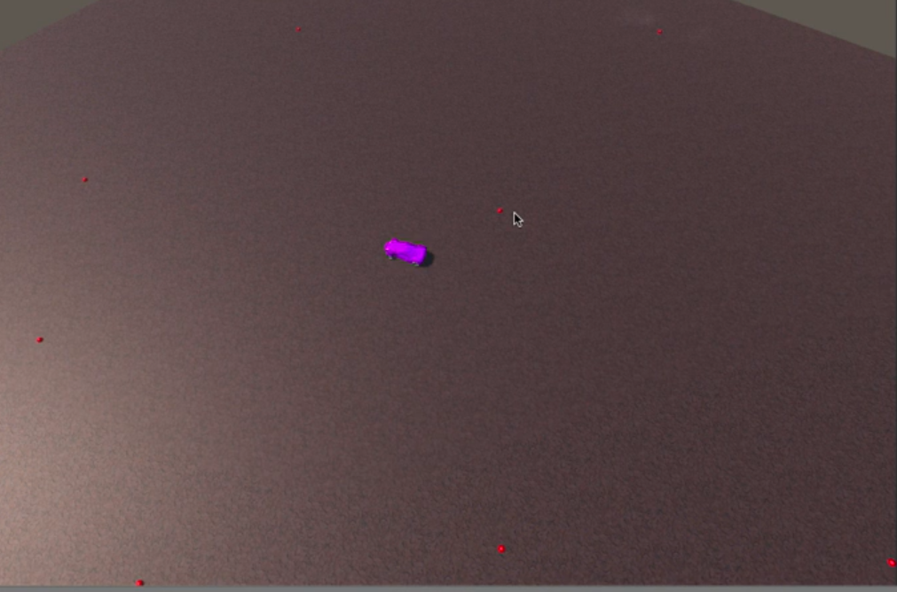
Section 3: Cars 17. Unity’s Vehicle System
Unity has an advanced Vehicle System that uses the waypoint circuit and ProgressTacker.
Need to import Utility asset (contains the waypoint circuit and progress tracker)
Also need to import the Standard Assets Vehicles
Comes with its own waypoint target (cube)
Can adjust behaviour of the car simply by adjusting the many parameters
Duplicate a car and you get a fully functioning second car
You can customize the car with your own model but wheel must be aligned properly

